Slide 1
Chapter 1
Introduction
1 -<number>

Slide 2
Why Do We Need to Study Algorithms?
To learn strategies to design efficient algorithms.
To understand the difficulty of designing good algorithms for some problems, namely NP-complete problems.
1 -<number>

Slide 3
Consider the Sorting Problem
Sorting problem:
To sort a set of elements into increasing or decreasing order.
  11, 7, 14, 1, 5, 9, 10
↓sort
1, 5, 7, 9, 10, 11, 14
Insertion sort
Quick sort
1 -<number>

Slide 4
Comparison of Two Algorithms Implemented on Two Computers
A bad algorithm implemented on a fast computer does not perform as well as
a good algorithm implemented on a slow computer.
1 -<number>

Slide 5
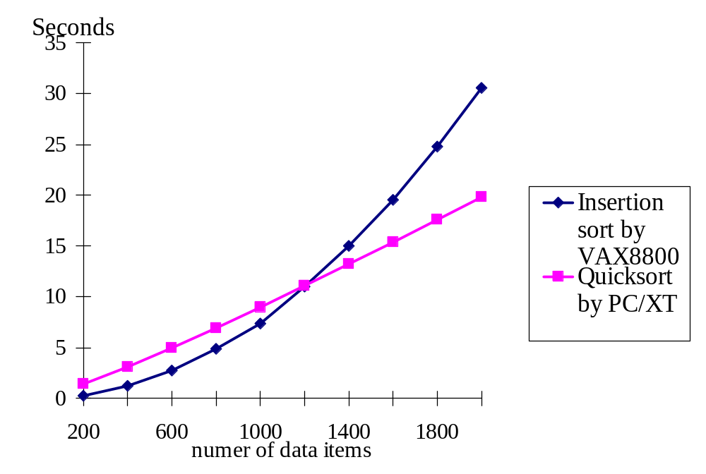
1 -<number>

Slide 6
Analysis of Algorithms
Measure the goodness of algorithms
  efficiency
  asymptotic notations: e.g. O(n²)
  worst case
  average case
  amortized
Measure the difficulty of problems
  NP-complete
  undecidable
  lower bound
Is the algorithm optimal?
1 -<number>
Notes:
Measure the goodness of algorithms 評斷演算法的好壞
Worst case 最糟的
Amortized 貪評法
Measure the fiddiculty of problems 評斷問題困難度
Undecidable 無法預知

Slide 7
0/1 Knapsack Problem
Given a set of n items where each item P_{i} has a value V_{i}, weight W_{i} and a limit M of the total weights, we want to select a subset of items such that the total weight does not exceed M and the total value is maximized.
1 -<number>

Slide 8
0/1 Knapsack Problem
M(weight limit) = 14
best solution: P₁, P₂, P₃, P₅ (optimal)
This problem is NP-complete.
 | P₁ | P₂ | P₃ | P₄ | P₅ | P₆ | P₇ | P₈
Value | 10 | 5 | 1 | 9 | 3 | 4 | 11 | 17
Weight | 7 | 3 | 3 | 10 | 1 | 9 | 22 | 15
1 -<number>

Slide 9
Traveling Salesperson Problem
Given: A set of n planar points
Find: A closed tour which includes all points exactly once such that its total length is minimized.
This problem is NP-complete.
1 -<number>

Slide 10
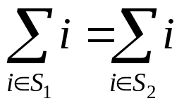
Partition Problem
Given: A set of positive integers S
Find S₁ and S₂ such that S₁∩S₂=∅, S₁∪S₂=S,
(Partition into S₁ and S₂ such that the sum of S₁ is equal to that of S₂)
e.g. S={1, 7, 10, 4, 6, 8, 13}
  S₁={1, 10, 4, 8, 3}
  S₂={7, 6, 13}
This problem is NP-complete.
1 -<number>

Slide 11
Art Gallery Problem
Given: an art gallery
Determine: min # of guards and their placements such that the entire art gallery can be monitored.
This problem is NP-complete.
1 -<number>

Slide 12
Minimal Spanning Trees
Given a weighted graph G, a spanning tree T is a tree where all vertices of G are vertices of T and if an edge of T connects V_{i} and V_{j}, its weight is the weight of e(V_{i},V_{j}) in G.
A minimal spanning tree of G is a spanning tree of G whose total weight is minimized.
1 -<number>

Slide 13
Minimum Spanning Trees
graph: greedy method
# of possible spanning trees for n points: n^{n-2}
n=10→10⁸, n=100→10¹⁹⁶
1 -<number>

Slide 14
Convex Hull
Given a set of planar points, find a smallest convex polygon which contains all points.
It is not obvious to find a convex hull by examining all possible solutions.
divide-and-conquer
1 -<number>

Slide 15
One-Center Problem
Given a set of planar points, find a smallest circle which contains all points.
Prune-and-search
1 -<number>

Slide 16
Many strategies, such as the greedy approach, the divide-and-conquer approach and so on will be introduced in this book.
1 -<number>

